Slide 1

WELCOME TO UNITY

Slide 2
What you will learn in this Course
Basic
Animation & Physics
Implement
- Working with Unity
- GameObjec and basic components
- Animation Scripting and Interactions
- UI Design
- UI Systems
- Applying Scripting and Physics
- Implementing Animations and UI
- Debugging and Troubleshooting
Unity
C#
Animations &
Physics system
Physics Engine
Final Project
Introduction
C# programming
in Unity
L0.1
LO.2
LO.3
LO.4
LO.6
C# in Unity
Physics Engine
- How to use C# in Unity
- C# script and other component of GameObject
- I/O interaction
- Rigidbody
- Collisions & Triggers
- Scoring Systems

Slide 3
Using of Unity
Game development
Interactive Experiences
Previsualization for Film
Architectural Visualization
Animation
Simulations

Slide 4
Module 1
Introduction to Unity Interface and Navigation

Slide 5
Learning Objectives
Familiarize with key components of Unity's interface.
Learn efficient navigation techniques.
Understand the role of various panels and tools.

Slide 6
Introduction to Unity
Unity is a professional-quality game engine used to create video games targeting a variety of platforms. Not only is it a professional development tool used daily by thousands of seasoned game developers, it’s also one of the most accessible modern tools for novice game developers.
1: Hocking, Joseph; Schell, Jesse, Unity in action: multiplatform game development in C#, 2022
9: Tutorials Point, Learning Unity, 2023

Slide 7
Introduction to Unity
Unity is a cross-platform game engine initially released by Unity Technologies, in 2005. The focus of Unity lies in the development of both 2D and 3D games and interactive content. Unity now supports over 20 different target platforms for deploying, while its most popular platforms are the PC, Android and iOS systems.
Unity features a complete toolkit for designing and building games, including interfaces for graphics, audio, and level-building tools, requiring minimal use of external programs to work on projects.
9: Tutorials Point, Learning Unity, 2023

Slide 8
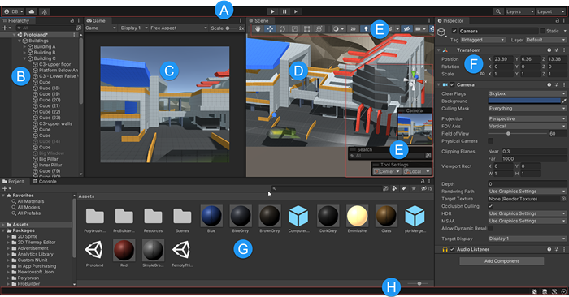
Unity Interface Components
8: Unity Technologies, Unity Manual, 2023
Notes:
• Overview of essential interface elements: Scene view, Game view, Hierarchy, Project panel, Inspector, and Toolbar.
• Explanation of how each component contributes to the game development workflow.
https://docs.unity3d.com/Manual/UsingTheEditor.html

Slide 9
Unity Interface Components
(A) The Toolbar provides access to your Unity Account and Unity Cloud Services. It also contains controls for Play mode; Undo history; Unity Search; a layer visibility menu; and the Editor layout menu.
(B) The Hierarchy window is a hierarchical text representation of every GameObject
in the Scene. Each item in the Scene has an entry in the hierarchy, so the two windows are inherently linked. The hierarchy reveals the structure of how GameObjects attach to each other.
(C) The Game view simulates what your final rendered game will look like through your Scene Cameras. When you click the Play button, the simulation begins.
(D) The Scene view allows you to visually navigate and edit your Scene. The Scene view
can display a 3D or 2D perspective, depending on the type of Project you are working on.
8: Unity Technologies, Unity Manual, 2023

Slide 10
Unity Interface Components
(E) Overlays contain the basic tools for manipulating the Scene view and the GameObjects within it. You can also add custom Overlays to improve your workflow.
(F) The Inspector window allows you to view and edit all the properties of the currently selected GameObject. Because different types of GameObjects have different sets of properties, the layout and contents of the Inspector window change each time you select a different GameObject.
(G) The Project window displays your library of Assets that are available to use in your Project. When you import Assets into your Project, they appear here.
(H) The status bar provides notifications about various Unity processes, and quick access to related tools and settings.
8: Unity Technologies, Unity Manual, 2023

Slide 11
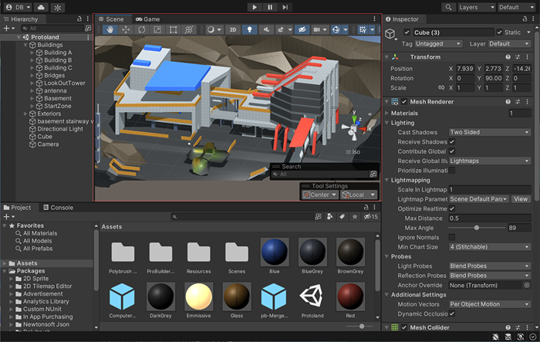
Scene View
8: Unity Technologies, Unity Manual, 2023
Notes:
https://docs.unity3d.com/2021.1/Documentation/Manual/UsingTheEditor.html

Slide 12
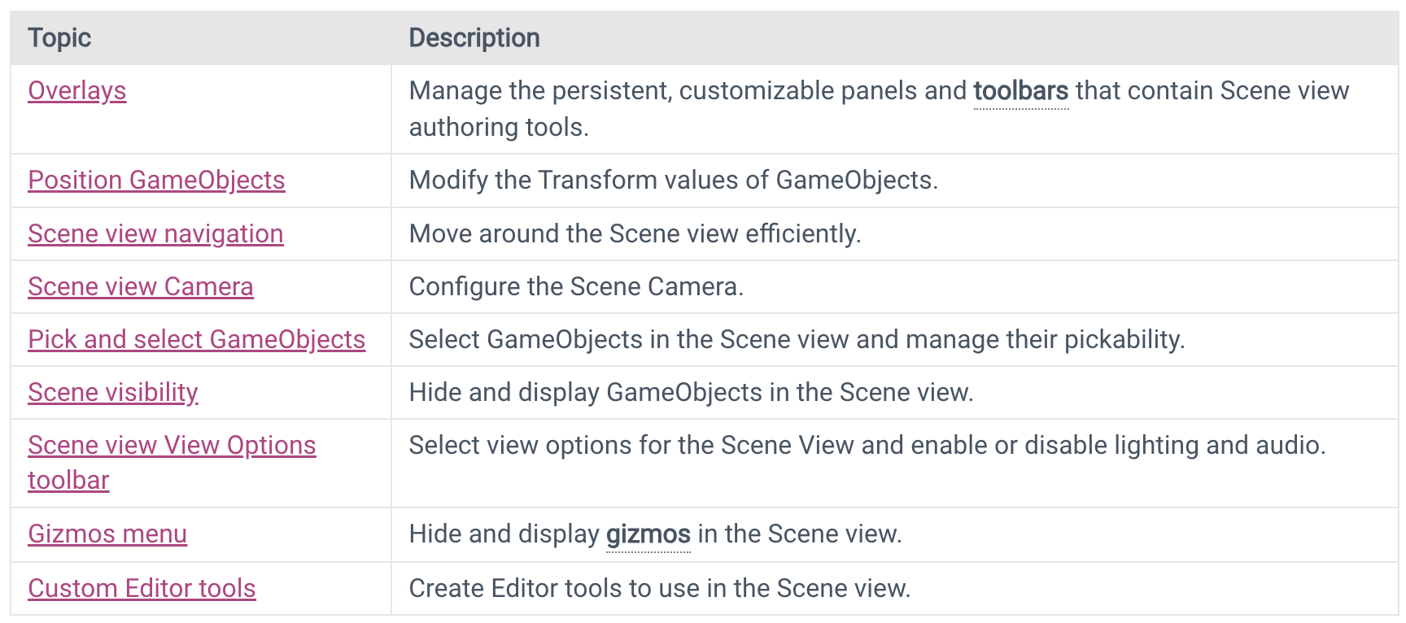
Scene View
The Scene view is where you visualize and interact with the world you create in the Editor. In the Scene view, you can select, manipulate, and modify GameObjects that act as scenery, characters, cameras, lights, and more.

Slide 13
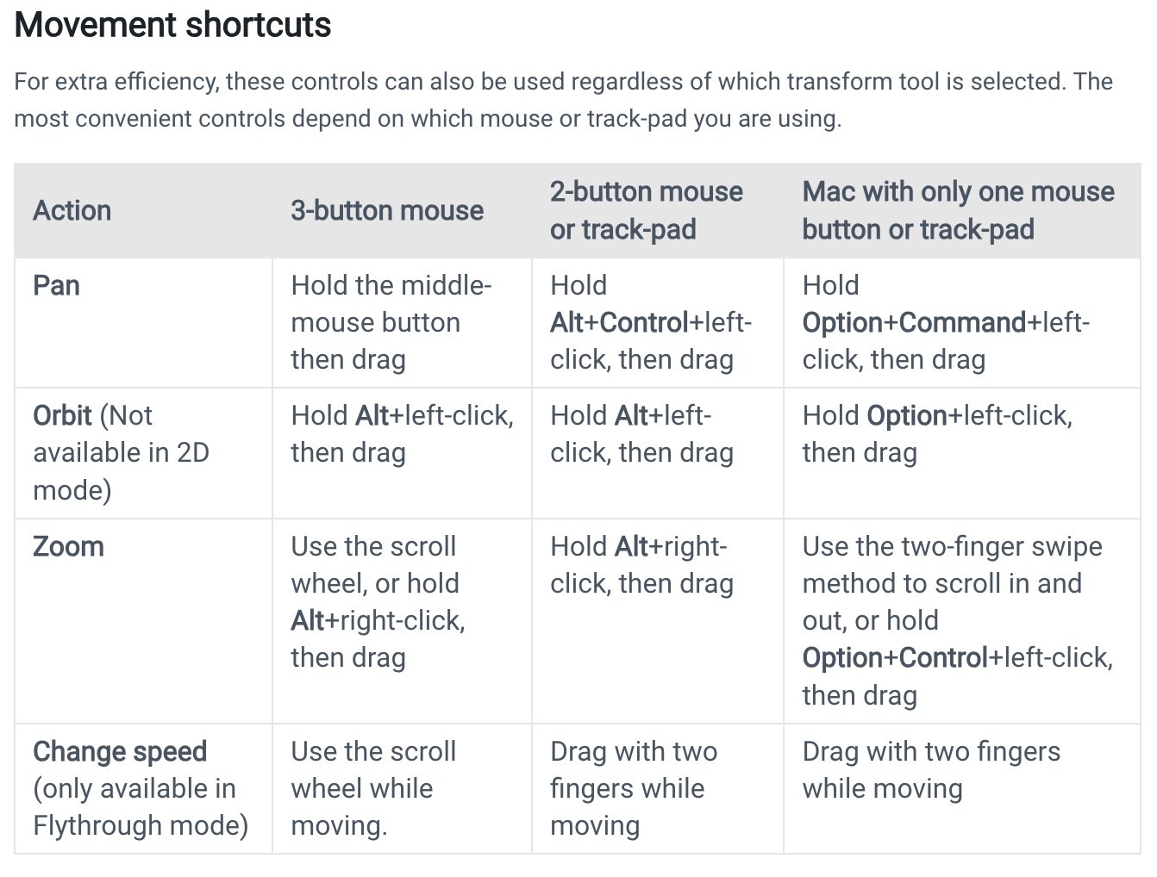
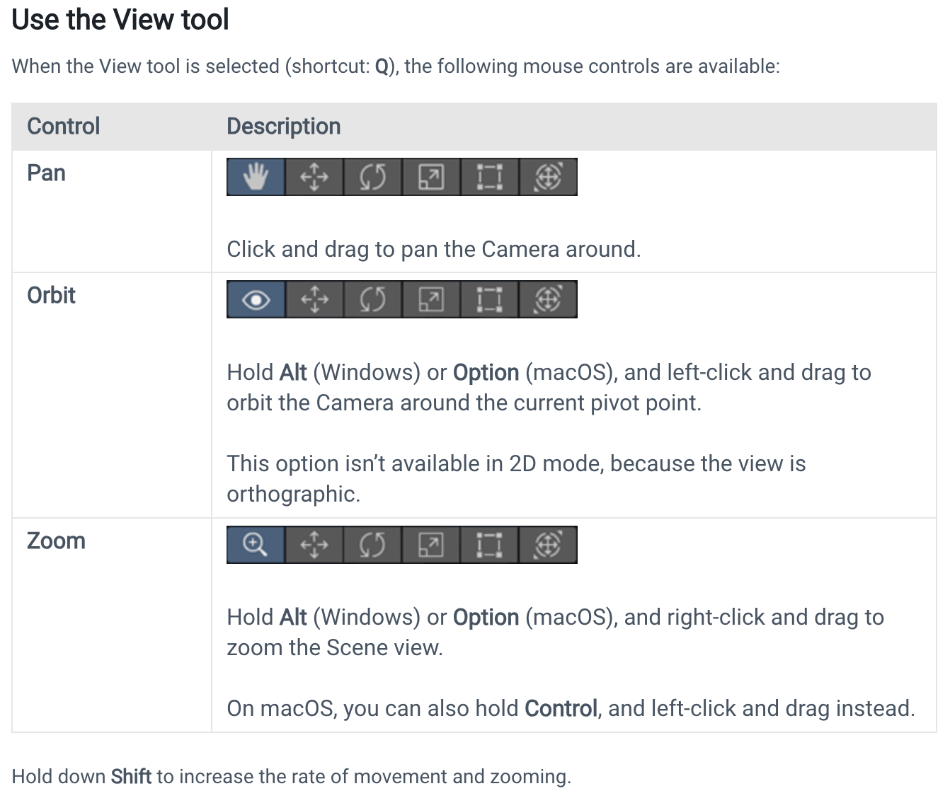
Scene View Navigation

Slide 14
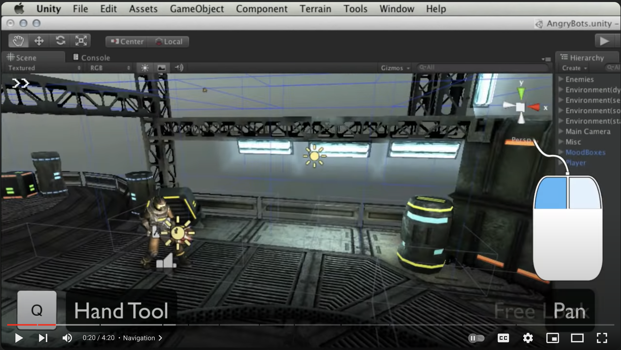
Scene View Navigation
Scene View navigation tutorial video
The Scene View - Unity Official Tutorials
Tutorial Video Source: https://www.youtube.com/watch?v=fxJR2pHPyTQ
Notes:
Aims for students to be able to operate on the scene view, using videos to guide basic operations with mouse and keyboard on Unity.
Click on image to open
OR “The Scene View - Unity Official Tutorials” link to open youtube

Slide 15
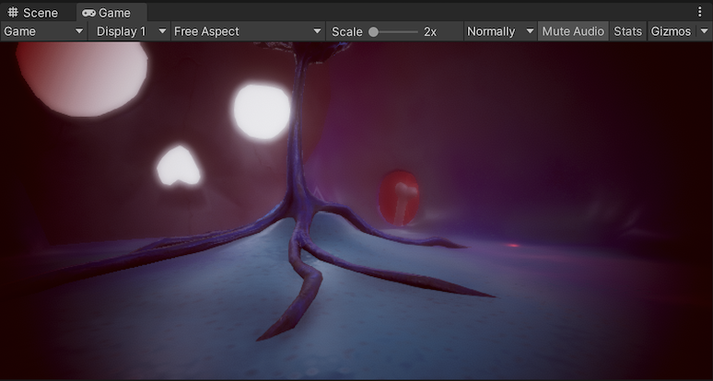
Game View
The Game view is rendered from the Camera(s) in your application. It shows how the final, built application looks. You need to use one or more Cameras to control what the player sees when they are using your application.

Slide 16
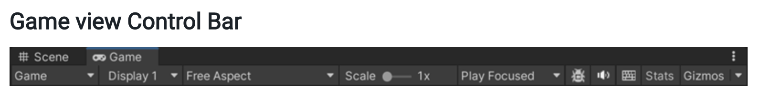
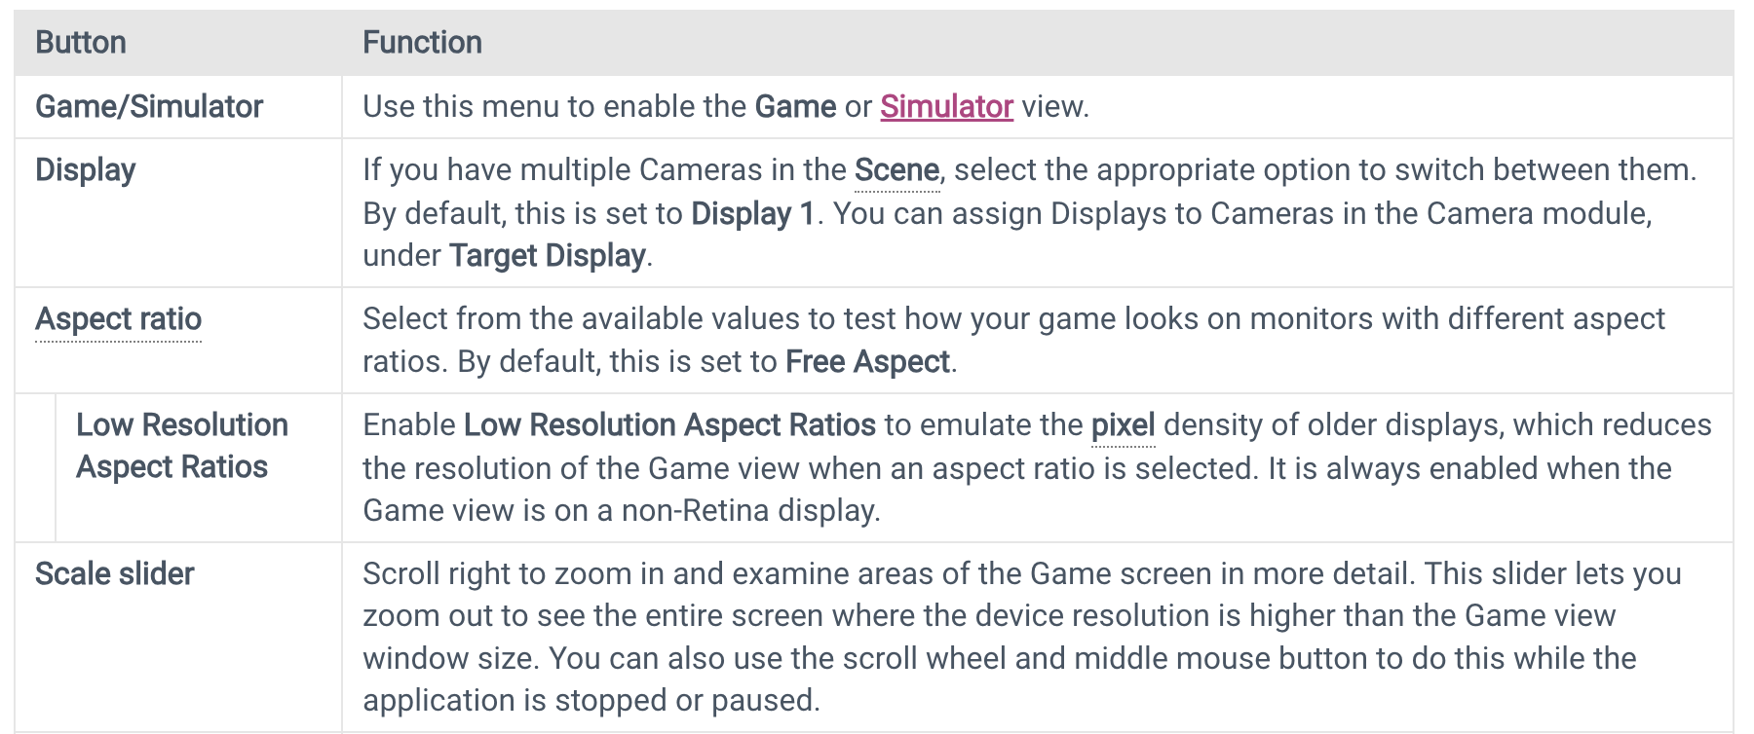
Game View
8: Unity Technologies, Unity Manual, 2023

Slide 17
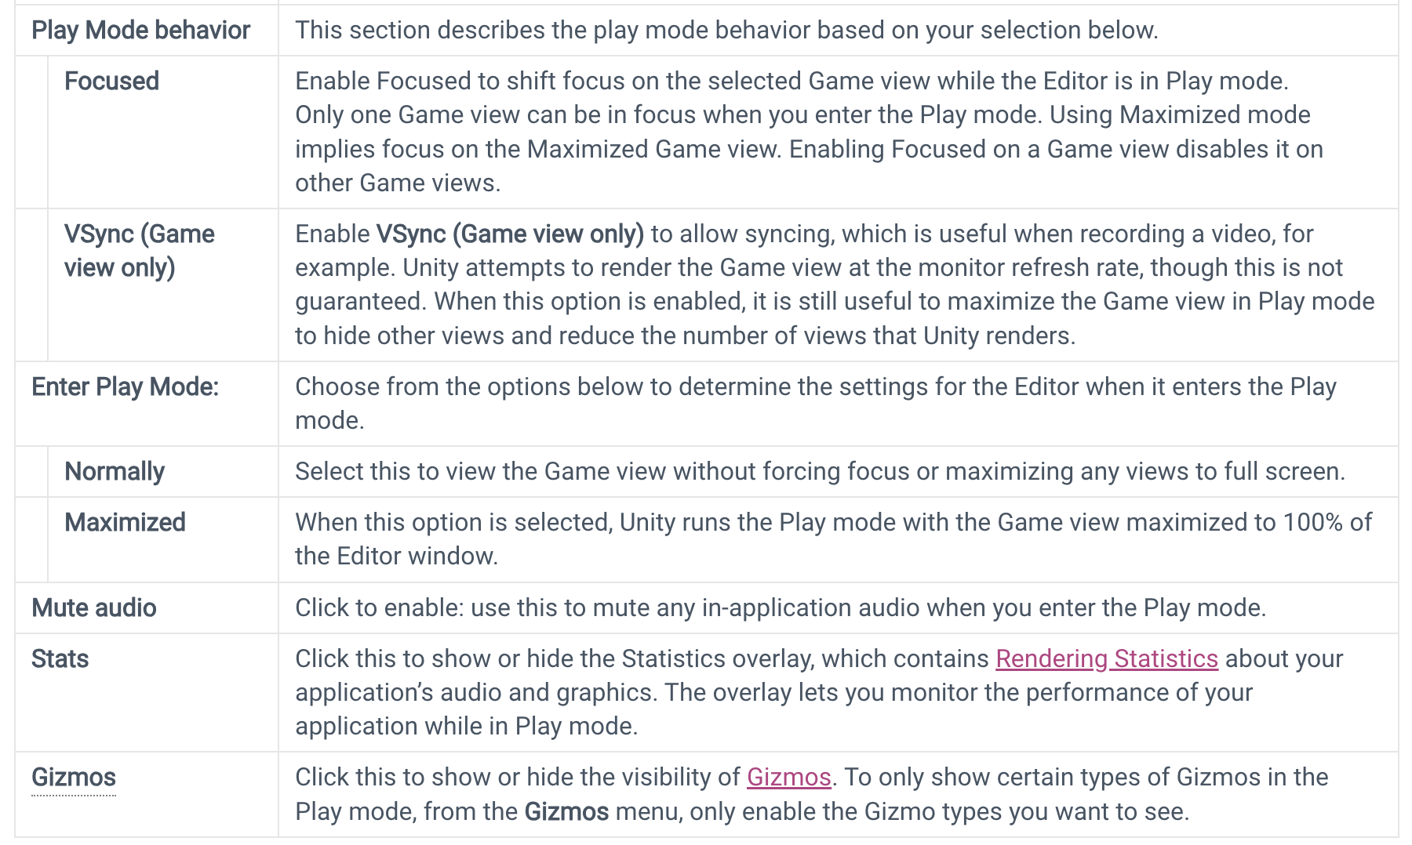
Game View
8: Unity Technologies, Unity Manual, 2023

Slide 18
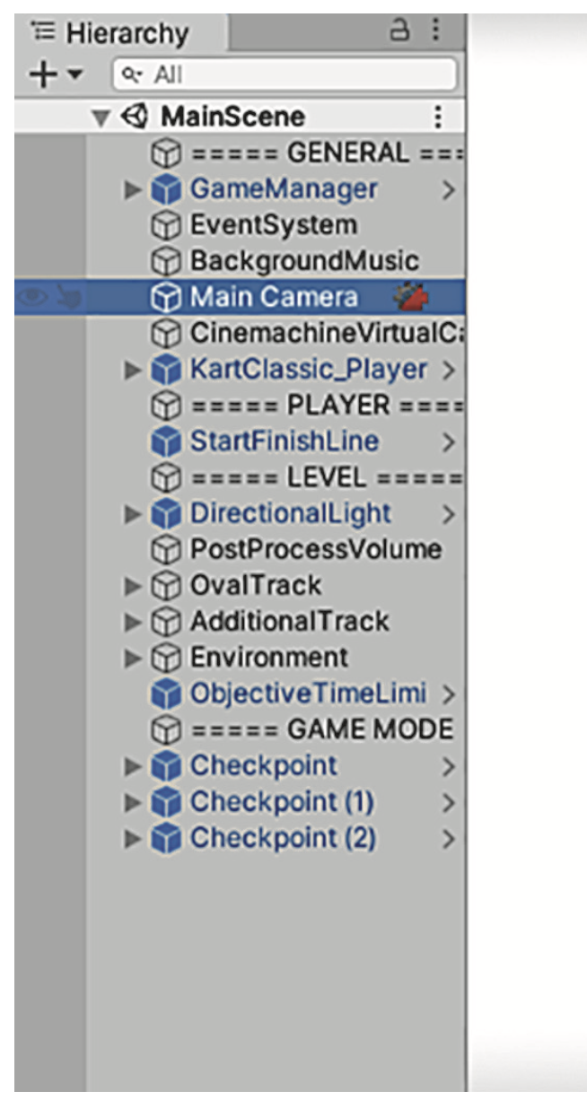
Hierarchy View
Hierarchy lists the name of every object in the scene and nests the names together according to their hierarchy linkages in the scene.
Basically, it’s a way of selecting objects by name instead of hunting them down and clicking them within the Scene view.
The Hierarchy linkages group objects together visually, like folders, allowing you to move the entire group as one.
8: Unity Technologies, Unity Manual, 2023

Slide 19
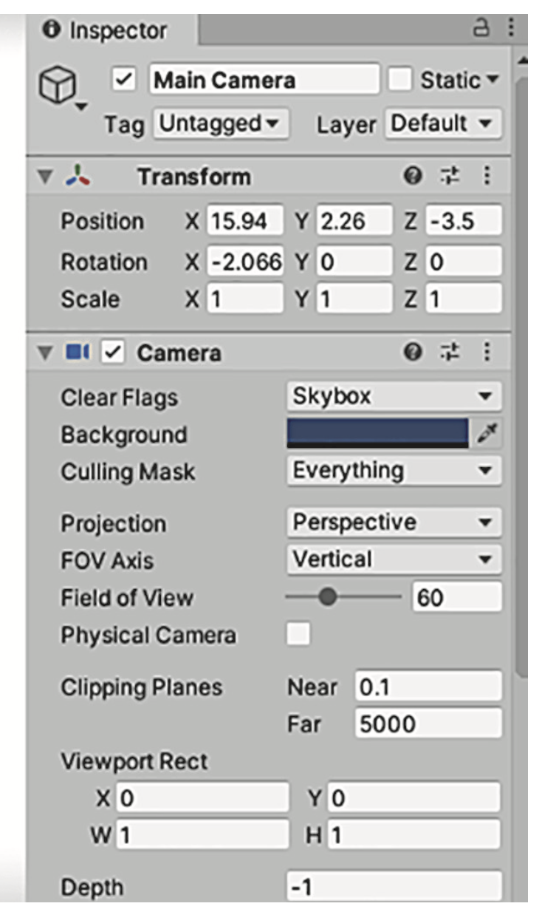
Inspector Panel
The Inspector shows you information about the currently selected object. Select an object, and the Inspector is then filled with information about that object. The information shown is pretty much a list of components, and you can even attach or remove components from objects.
8: Unity Technologies, Unity Manual, 2023

Slide 20
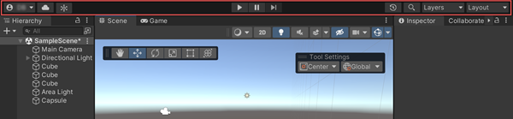
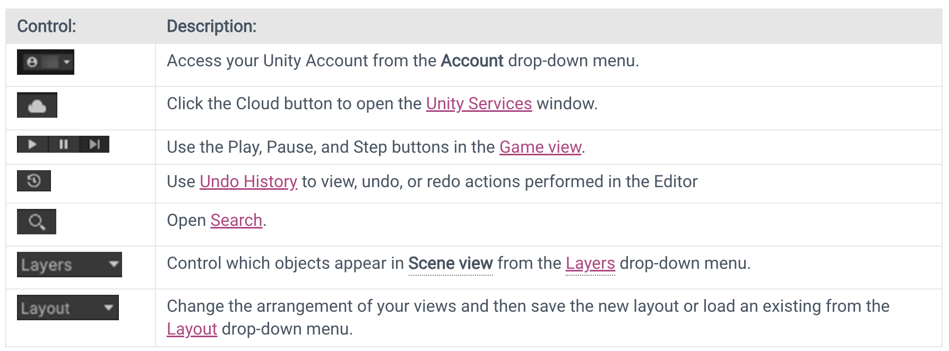
The Toolbar
You can find the Toolbar at the top of the Unity Editor. It is not a window, and is the only part of the Unity interface that you can’t rearrange.

Slide 21
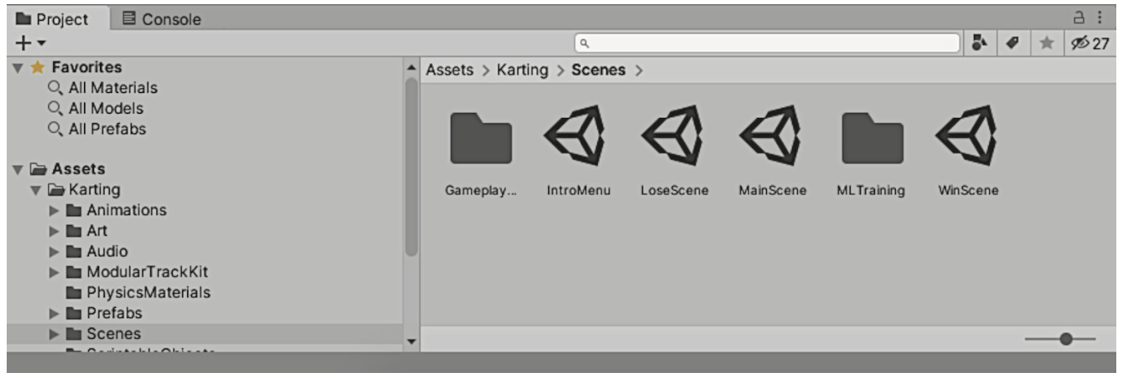
The Project and Console tabs
Project shows all the assets (art, code, and so on) in the project. Specifically, on the left side of the view is a listing of the project’s directories; when you select a directory, the right side of the view shows the individual files in that directory.
Project shows files that may not be contained within any specific scene.
8: Unity Technologies, Unity Manual, 2023

Slide 22
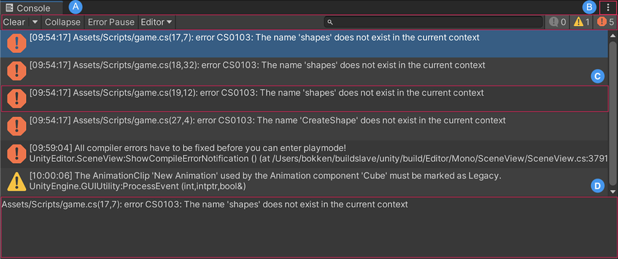
The Project and Console tabs
The Console tab is the place where messages from the code show up. Some of these messages will be debugging output that you placed deliberately, but Unity also emits error messages if it encounters problems in the script you wrote.

Slide 23
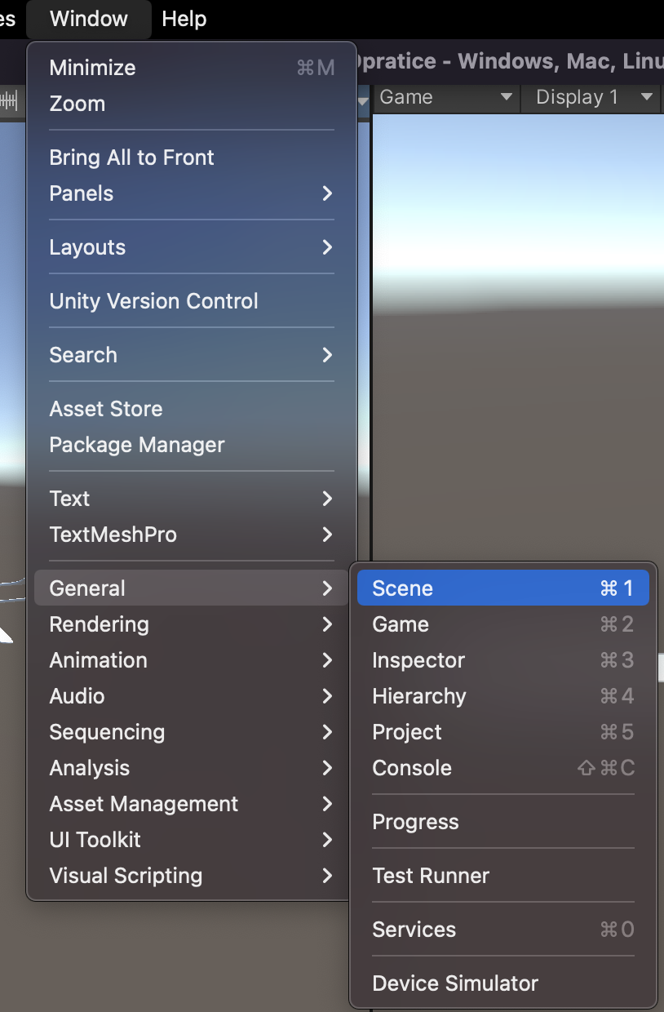
Customizing your workspace
You can customize your Layout of Views by click-dragging the Tab of any View to one of several locations. Dropping a Tab in the Tab Area of an existing window will add the Tab beside any existing Tabs. Alternatively, dropping a Tab in any Dock Zone will add the View in a new window.
If you can't find a panel on the layout, you can reopen it by going to the Window > General, and then choosing the panel you want to add.
8: Unity Technologies, Unity Manual, 2023
Notes:
https://docs.unity3d.com/Manual/CustomizingYourWorkspace.html

Slide 24
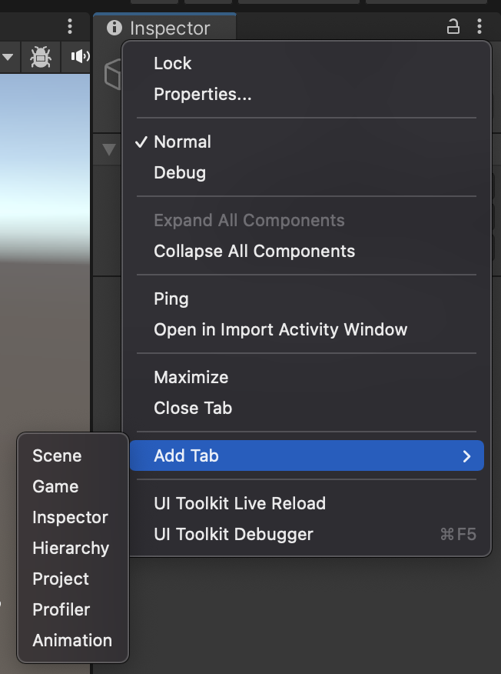
Customizing your workspace
If you can't find a panel on the layout, you can reopen it by going to the Window > General, and then choosing the panel you want to add.
Or you can click on the “Layout Options” button at the top right of each tab and choose “Add Tab”, to add a new panel.

Slide 25
Unity's Scripting Integration
Unity is deeply integrated with various scripting languages, with C# being the primary language used for scripting game logic within the Unity ecosystem.
Scripts in Unity play a pivotal role in adding interactivity to game objects.
These scripts define the behavior, interactions, and logic behind various game elements, making them dynamic and responsive to player input or events.
Scripts act as the backbone for game interactivity, enabling developers to define how game elements behave and respond in different situations or conditions.

Slide 26
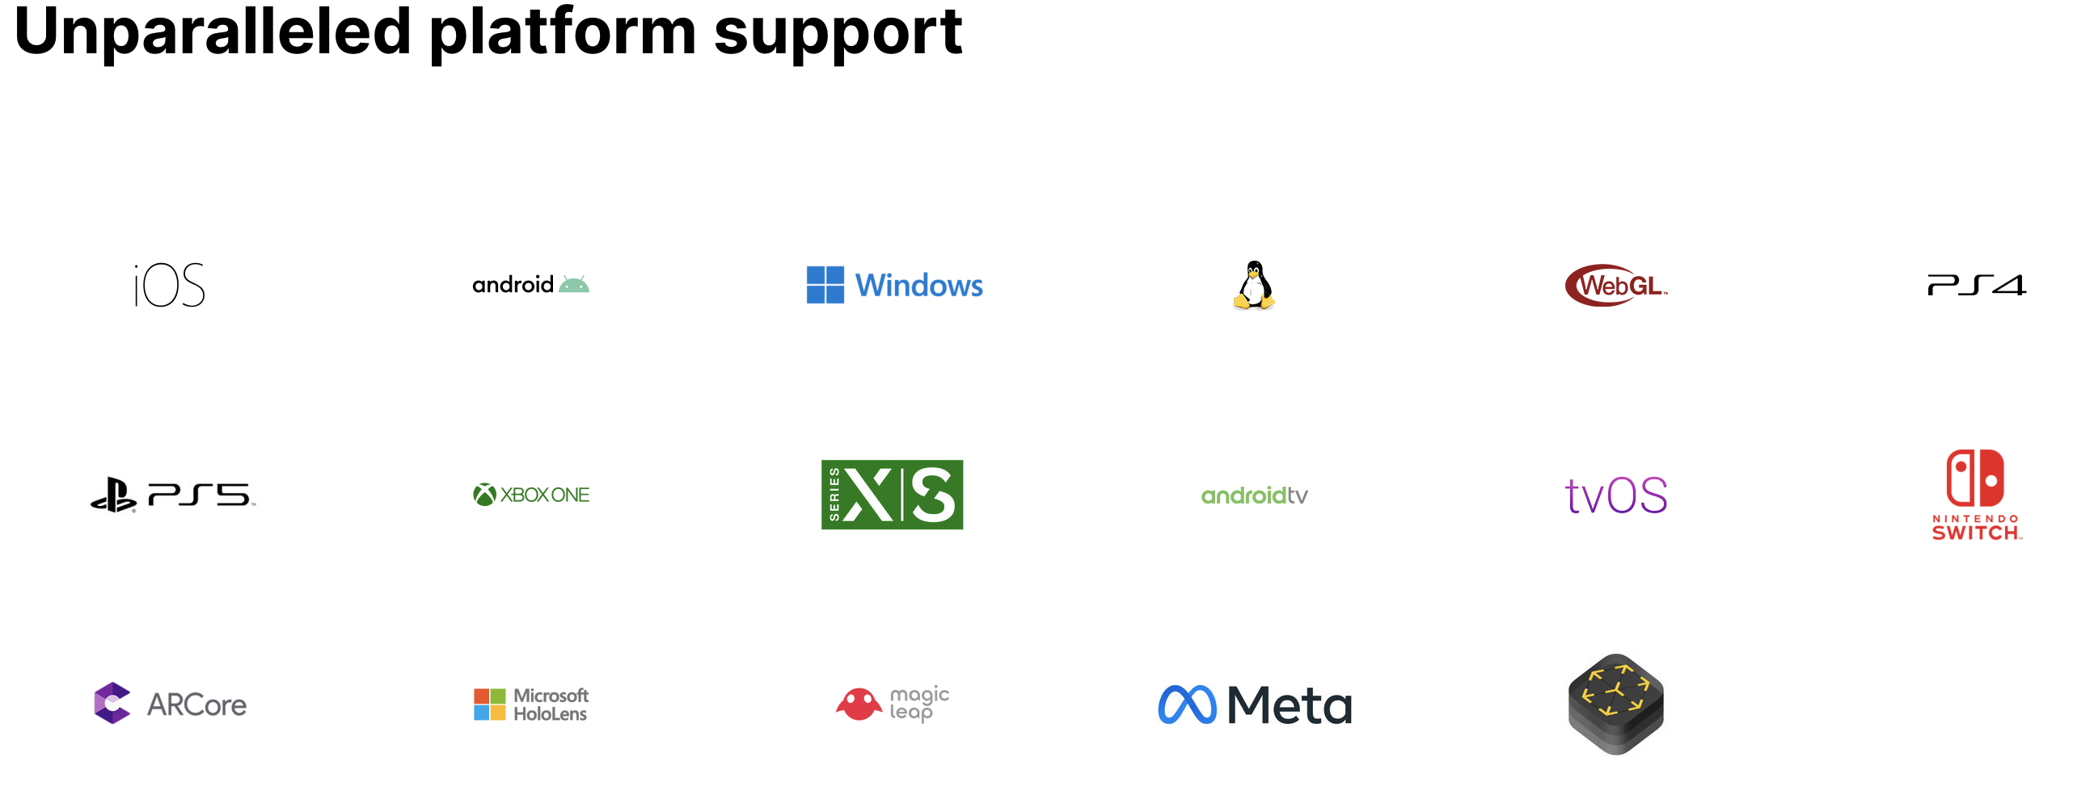
Cross-Platform Capabilities
Unity's cross-platform capabilities empower developers to create games and applications that can seamlessly run on multiple platforms, including mobile devices (iOS, Android), consoles, desktops (Windows, macOS), web browsers, AR/VR devices, and more.
Source: https://unity.com/solutions/multiplatform

Slide 27
Unity Community and Support
Unity Community
Forum: https://forum.unity.com/
Discussions: https://discussions.unity.com/
Community: https://unity.com/community
Unity Manual
https://docs.unity3d.com/ (*)
https://learn.unity.com/
Unity Asset Store
https://assetstore.unity.com/

Slide 28
Summary
Understanding Unity's Interface: Explored the fundamental components—Scene view, Game view, Hierarchy, Project panel, Inspector, and Toolbar—underlining their roles in the game development workflow.
Panel and Tool Roles: Emphasized the significance of each panel and tool, detailing their contributions to game creation, manipulation, and asset management.
Scripting and Cross-Platform Capabilities: Introduced Unity's scripting integration, highlighting the role of scripts in adding interactivity, and discussed Unity's cross-platform adaptability for diverse deployment.

Slide 29
References
1: Hocking, Joseph; Schell, Jesse, Unity in action: multiplatform game development in C#, 2022
3: Geig, Mike, Sams teach yourself Unity Game development in 24 hours, 2014
8: Unity Technologies, Unity Manual, 2023
9: Tutorials Point, Learning Unity, 2023

